Slide 1
Sales Insights using Power BI
Dhiraj Mahato

Slide 2
Problem Statement
Problem Statement: Sales Dashboard Insights
Our objective is to extract valuable insights from the sales database by creating interactive dashboards. These insights will illuminate key business terms, trends, and performance metrics. By visualizing sales data, we aim to empower decision-makers with actionable information for strategic planning and growth.

Slide 3
Project Description
In this project, I focused on analysing a sales database to derive meaningful insights and trends using Power BI for creating interactive dashboards. The process began with storing the sales data in a MySQL database, ensuring an efficient and organized backend for data management. I connected this MySQL database to Power BI, allowing for seamless data extraction and visualization.
Using Power BI, I developed various key sales metrics. The dashboards include interactive features like drill-downs and filters, enabling stakeholders to explore the data in detail and gain deeper insights. Additionally, I performed data cleaning and preprocessing to ensure the accuracy and reliability of the analysis.
Through this project, I provided a comprehensive view of sales performance, identifying trends and patterns that can inform strategic business decisions. The integration of MySQL and Power BI facilitated efficient data management and powerful visual representations, enhancing the overall decision-making process for the business.

Slide 4

Who are the End Users ?
01
Store Owners/ Managers
Marketing Team
02
Sales Team
Financial Analysts
03
04
Business Consultants
Data Analysts & Scientists
05
06
Supply Chain & Inventory Managers
07

Slide 5
Tcechnologies used
1. Power BI
Description: Power BI is our primary tool for creating interactive dashboards and visualizations.
Features:
Data Modelling: Power BI allows us to shape and transform data from various sources.
DAX (Data Analysis Expressions): We can create custom calculations and measures using DAX.
Report Publishing: Share reports securely with stakeholders.
2. MySQL
Description: MySQL serves as our relational database management system (RDBMS).
Key Points:
Open-Source: MySQL is widely used, efficient, and open-source.
Structured Data: It handles structured data storage and retrieval.

Slide 6
Results
Power BI File (Github)
Database Link

Slide 7
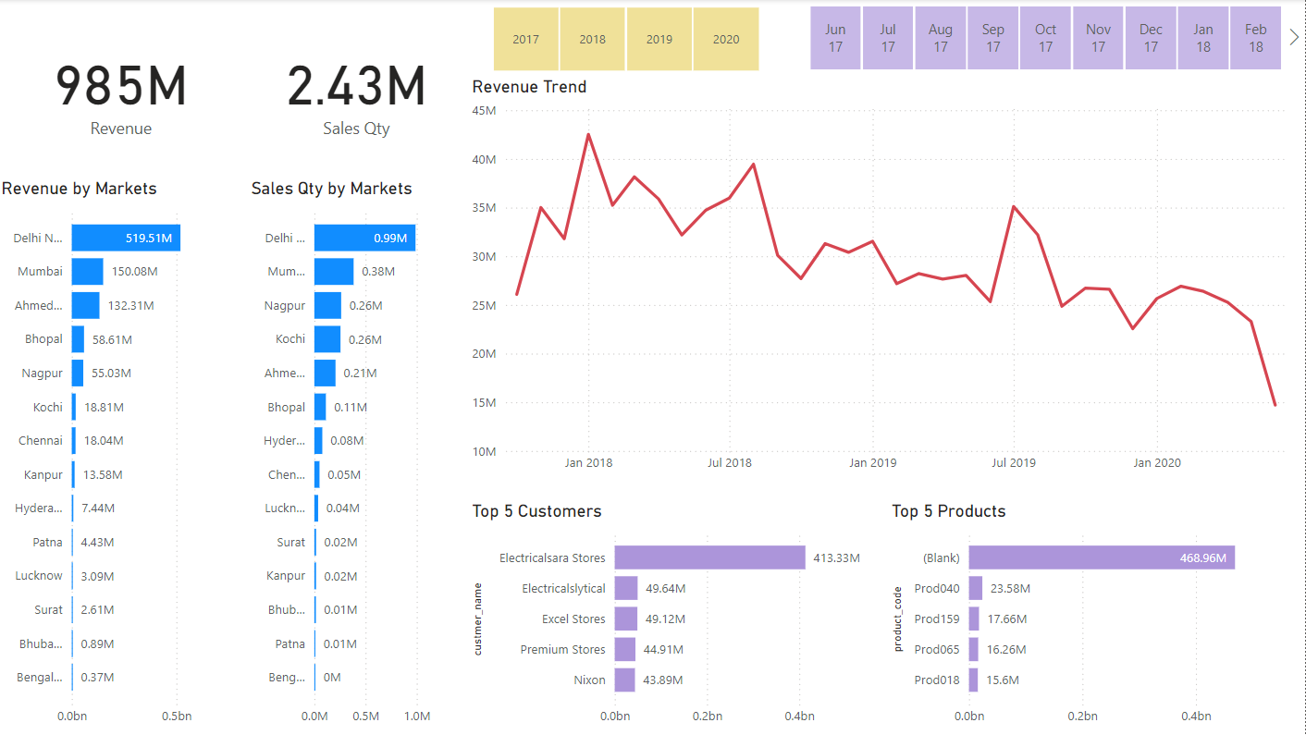
Power BI Dashboard

Slide 8

Thank You
LinkedIn
dhirajmahato832@gmail.com

